Slide 1
NETFLIX
Netflix Movies and TV shows Data
Analysis using SQL

Slide 2
Overview
This project involves a comprehensive analysis of Netflix's movies and TV shows data using SQL. The goal is to extract valuable insights and answer various business questions based on the dataset. The following README provides a detailed account of the project's objectives, business problems, solutions, findings, and conclusions.
Objectives
Analyze the distribution of content types (movies vs TV shows).
Identify the most common ratings for movies and TV shows.
List and analyze content based on release years, countries, and durations.
Explore and categorize content based on specific criteria and keywords.

Slide 3
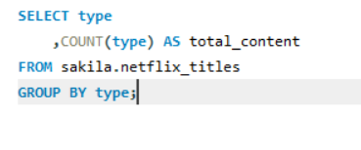
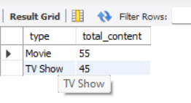
Business Problems and Solutions
Count the Number of Movies vs TV Shows
Objective: Determine the distribution of content types on Netflix.

Slide 4
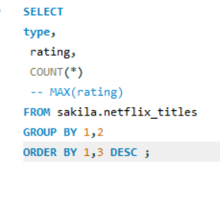
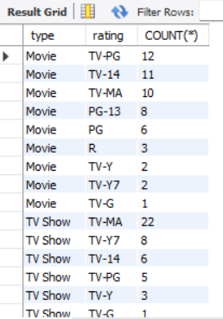
Find the Most Common Rating for Movies and TV Shows
Objective: Identify the most frequently occurring rating for each type of content.

Slide 5
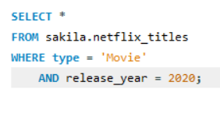
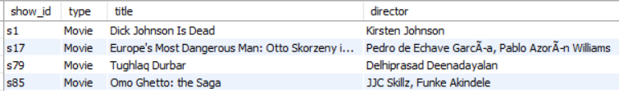
List All Movies Released in a Specific Year (e.g., 2020)
Objective: Retrieve all movies released in a specific year.

Slide 6
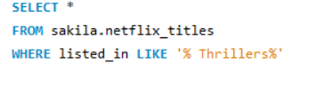
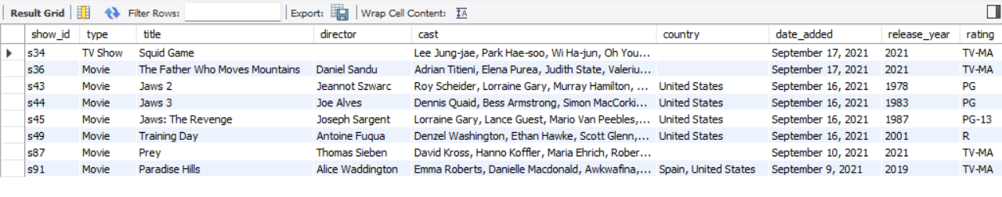
List All Movies that are Thrillers
Objective: Retrieve all movies classified as Thrillers.

Slide 7
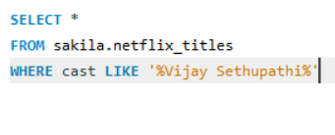
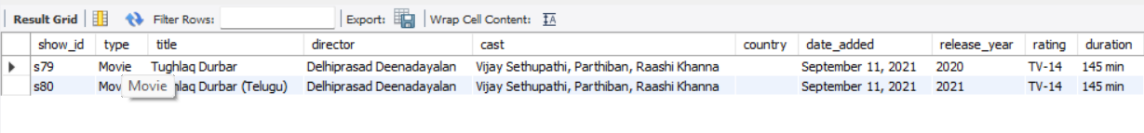
Find How Many Movies Actor 'Vijay Sethupathi' Appeared in the Last 10 Years
Objective: Count the number of movies featuring 'Vijay Sethupathi' in the last 10 years.

Slide 8
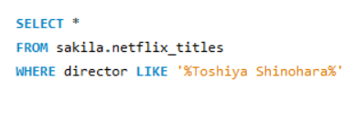
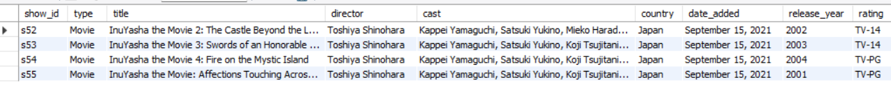
Find All Movies/TV Shows by Director 'Toshiya Shinohara'
Objective: List all content directed by 'Toshiya Shinohara'.

Slide 9
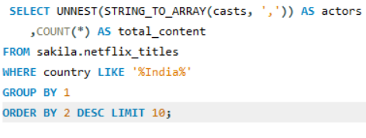
Find the Top 10 Actors Who Have Appeared in the Highest Number of Movies Produced in India

Slide 10
Findings and Conclusion
Content Distribution: The dataset contains a diverse range of movies and TV shows with varying ratings and genres.
Common Ratings: Insights into the most common ratings provide an understanding of the content's target audience.
Geographical Insights: The top countries and the average content releases by India highlight regional content distribution.
Content Categorization: Categorizing content based on specific keywords helps in understanding the nature of content available on Netflix.
This analysis provides a comprehensive view of Netflix's content and can help inform content strategy and decision-making.

